Slide 1
EUITREL: The EU’s Inter-regional and
Trans-regional Relations
Introduction
03/10/2024

Slide 2

Instant Polling App!: Socrative
Open GooglePlay or Appstore
Find and Download Socrative-Student (not Socrative-Teacher)
Open the app and join in the Class HM1205
Once you get the instruction, use the app for instant polling!!!

Slide 3
Socrative Trial!
Which one is not a bordering country to Turkey?
A. Georgia
B. Iraq
C. Azerbaijan
D. Bulgaria
E. Macedonia

Slide 4
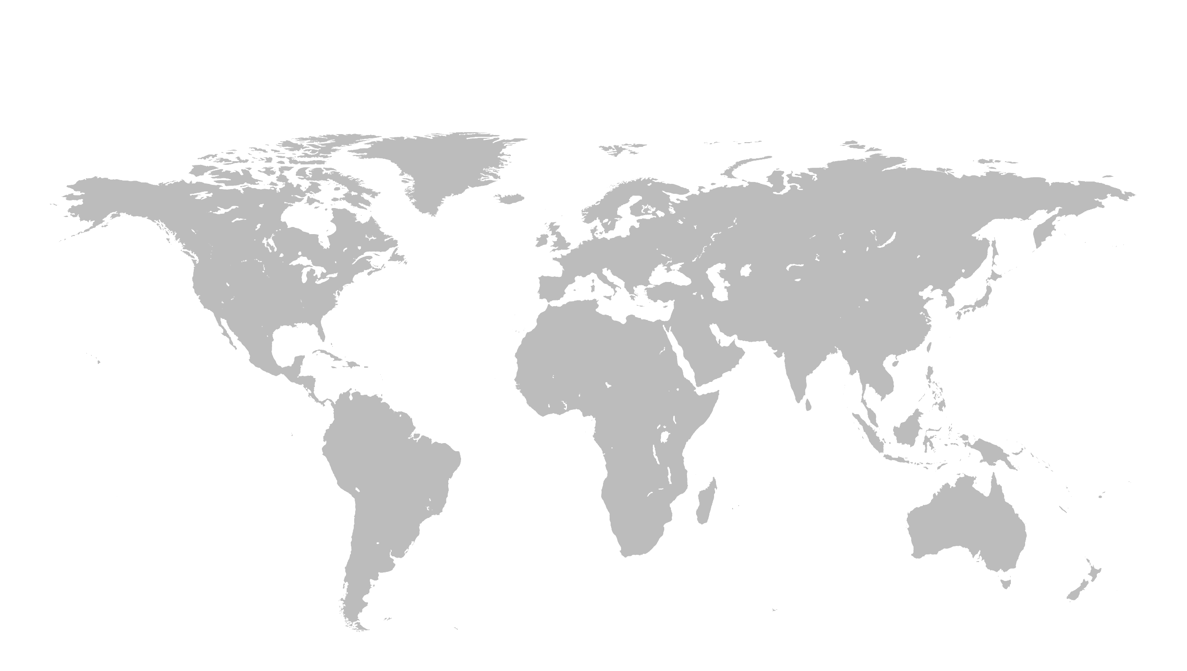
Locate Pacific Ocean
D
D
B
B
E
E
A
A
C
C

Slide 5
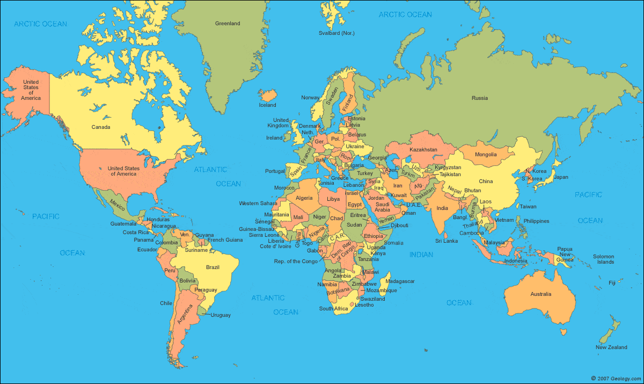
The World Map I

Slide 6
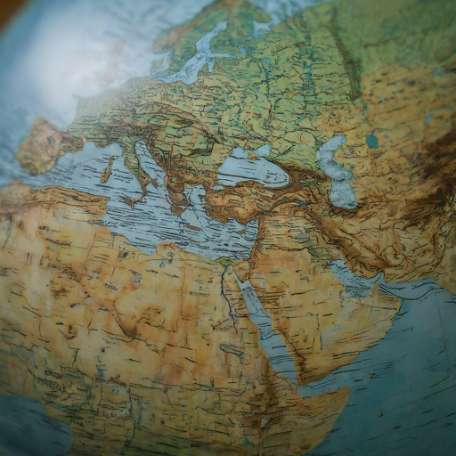
Mercatur’s Projection of Mapping
A conformal map that preserves angles between lines.
Used in many fields, including navigation, cartography, and geography.
Useful for navigation because it represents rhumb lines as straight segments.
Distorts the size of objects as the latitude increases from the Equator to the poles.

Slide 7
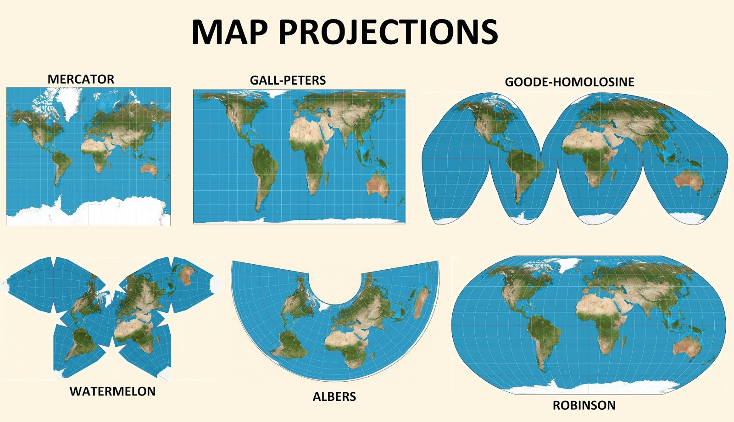

Slide 8
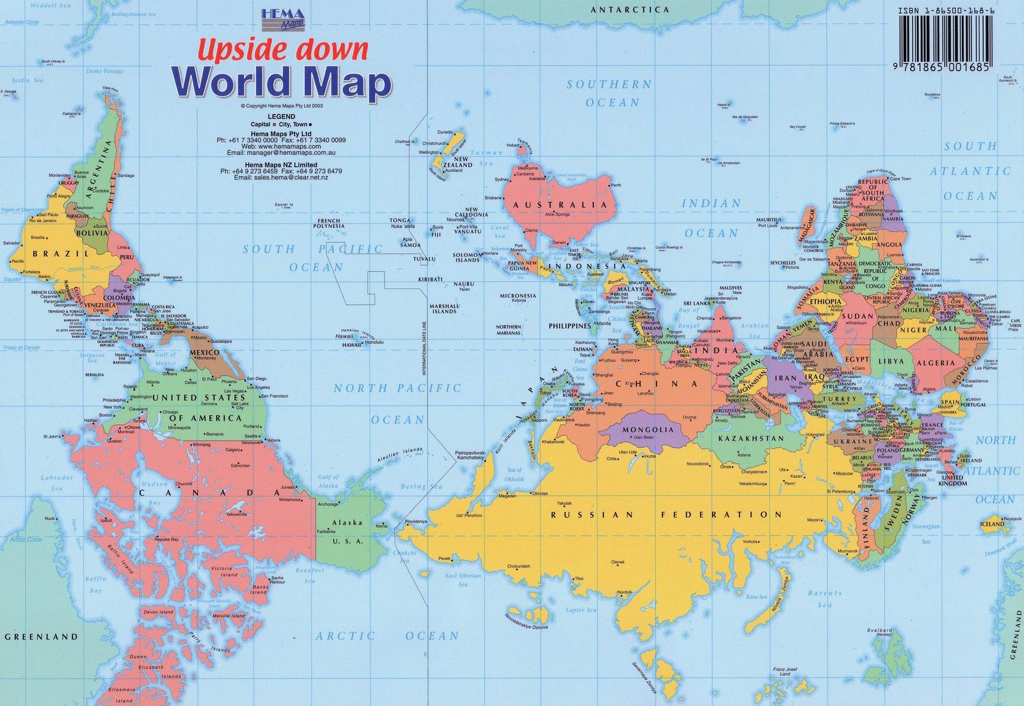
The World Map II
Notes:
Why do maps always show the north as up? For those who don’t just take it for granted, the common answer is that Europeans made the maps and they wanted to be on top. But there’s really no good reason for the north to claim top-notch cartographic real estate over any other bearing, as an examination of old maps from different places and periods can confirm.
The profound arbitrariness of our current cartographic conventions was made evident by McArthur’s Universal Corrective Map of the World, an iconic “upside down” view of the world that recently celebrated its 35th anniversary

Slide 9
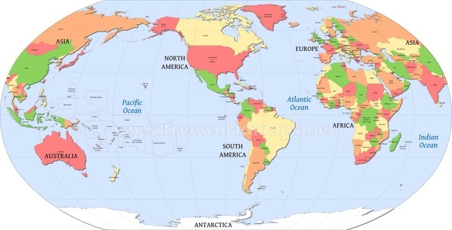
The World Map III

Slide 10
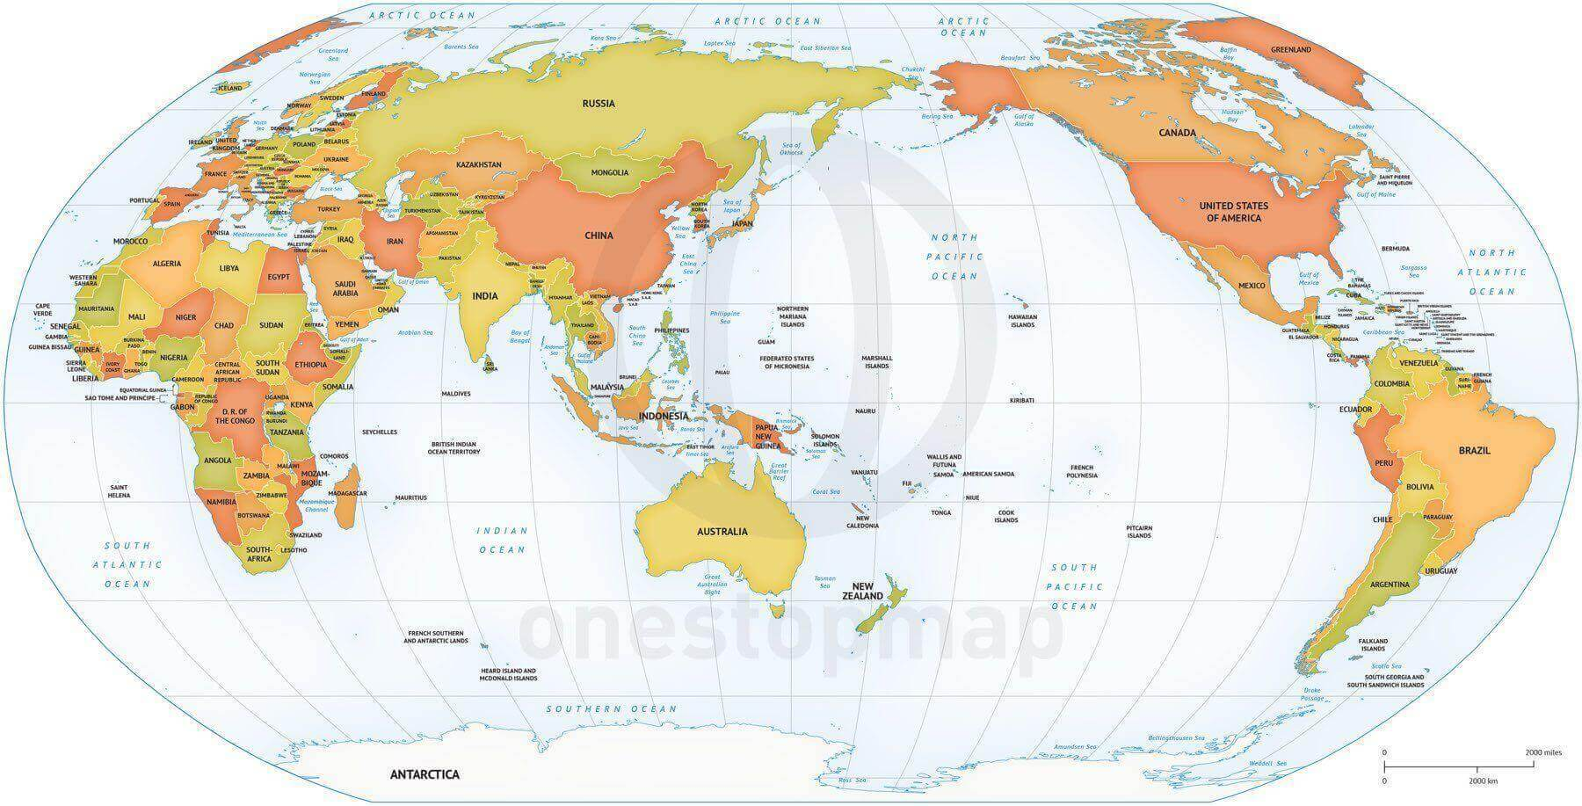
The World Map IV

Slide 11
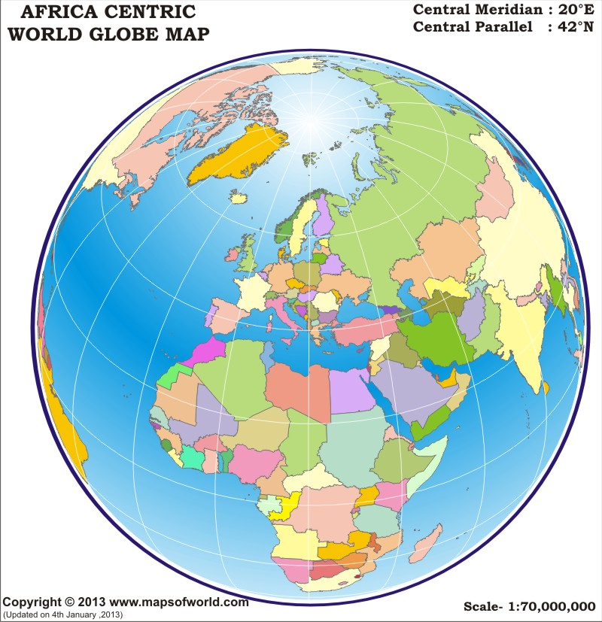
The World Map V

Slide 12
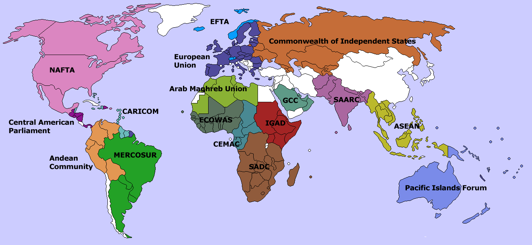
The World of Regions (Economy-politic)

Slide 13
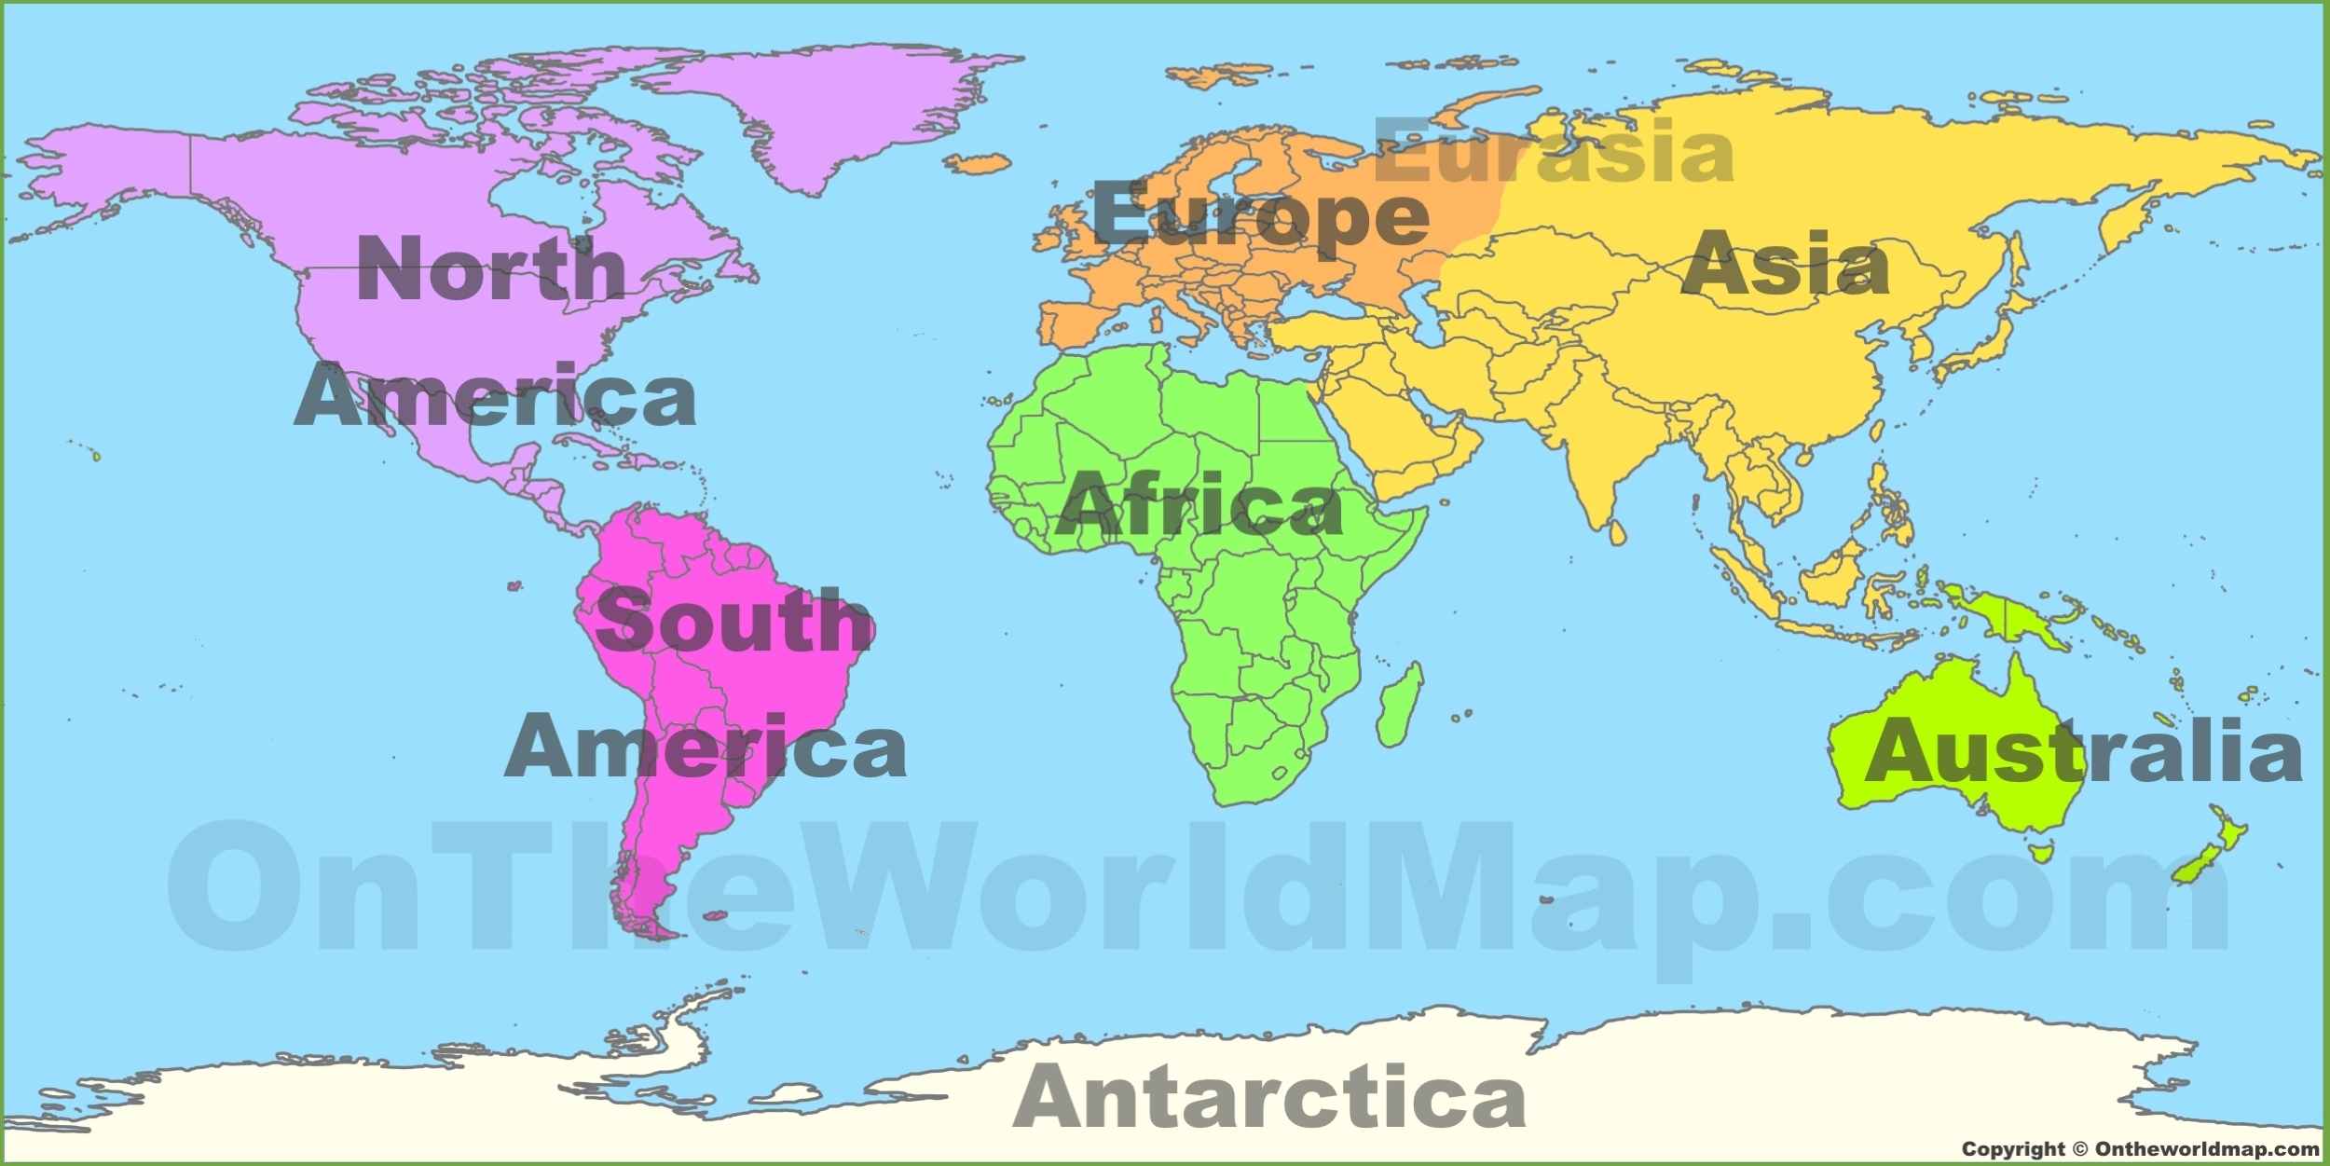
The World of Regions (Geographic)

Slide 14
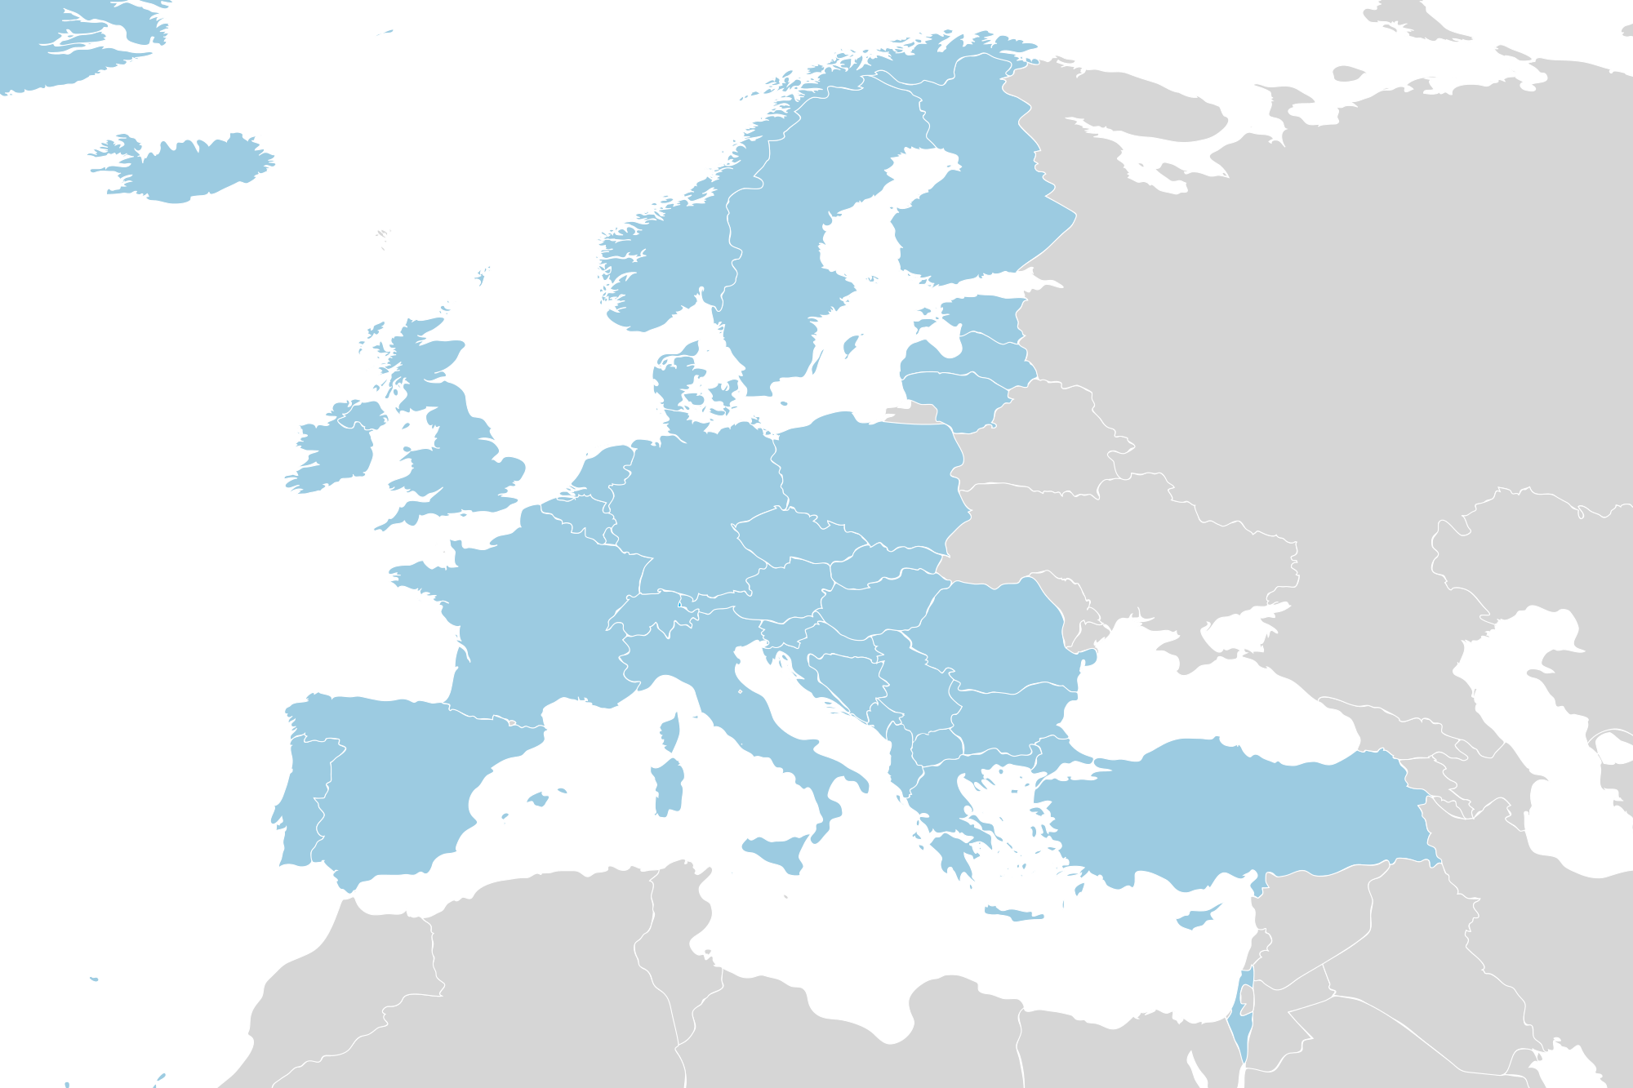
How to locate Turkey I

Slide 15
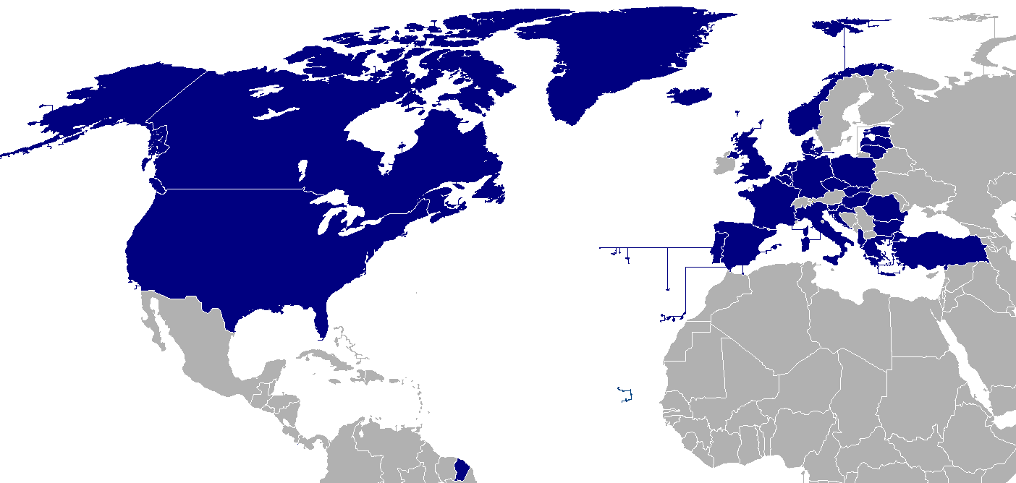
How to locate Turkey II

Slide 16
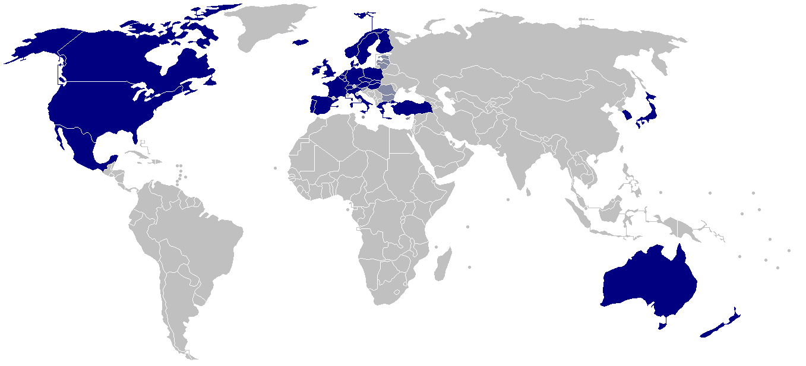
How to locate Turkey III

Slide 17
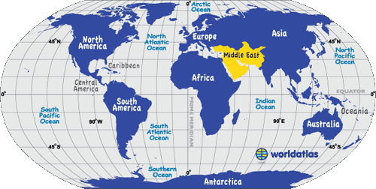
How to locate Turkey IV

Slide 18
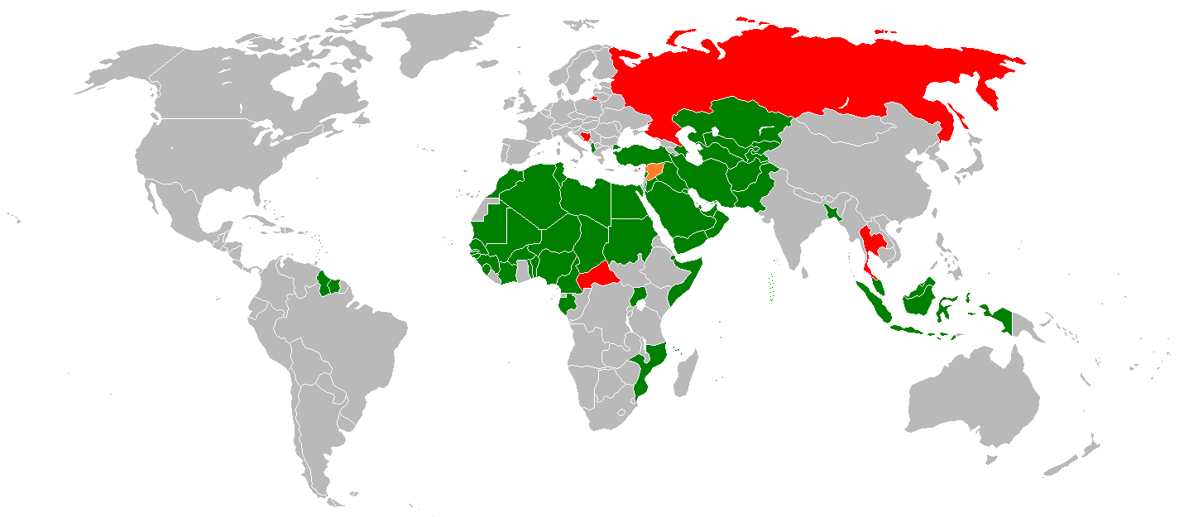
How to locate Turkey VI

Slide 19
Exploring Different Worldviews: Maps and Regionalism in a Globalized World
This exercise serves several purposes:
Highlighting Perspective: It emphasizes that maps are not objective representations but are created with certain perspectives in mind. Different maps can portray the same world in radically different ways.
Challenging Preconceptions: By examining maps that deviate from the norm, we encourage critical thinking and challenge preconceived notions about the world.
Setting the Stage: This exercise sets the stage for our discussions on regionalism and globalization by showcasing how geographical perceptions can influence political, economic, and cultural interactions among regions.

Slide 20
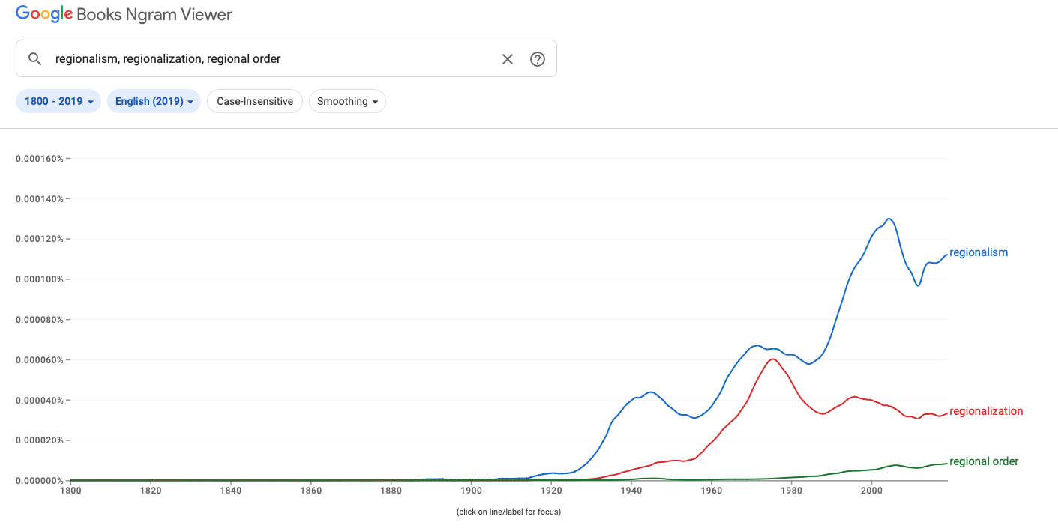
Regionalism on the Rise!

Slide 21
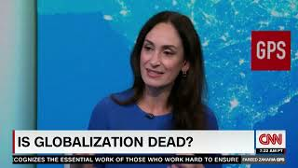

Slide 22
Main takeaways: The Globalization Myth
Why Regions Matter
By Shannon K. O’Neil
Embracing and deepening regional ties is a way to succeed in an internationally connected and competitive world.
The biggest feature of globalization over the last forty years has been the creation of international supply chains. This has spurred regionalization more than globalization.
Regional commercial ties have given nations and geographic regions a competitive economic edge in the world economy, and help explain the so-called winners and losers of globalization.
Trends in automation, climate change, demographics, consumer behavior, and geopolitics are changing economic and commercial calculations, and trade and investment patterns. These shifts generally favor regionalization for economic competitiveness. Deepening regional supply chains and ties are vital for companies to have a competitive edge.

Slide 23

Regionalism vs. Globalization
Regionalism: political and economic integration within a specific geographic region.
Globalization: Interconnectedness and integration of economies, societies, and cultures worldwide.
Tensions: Regionalism may lead to protectionism, hindering global trade and cooperation.
Benefits: Regionalism can foster economic growth, stability, and shared problem-solving within regions.
Interplay: Both processes coexist and shape international relations, requiring a balance between regional and global interests.

Slide 24
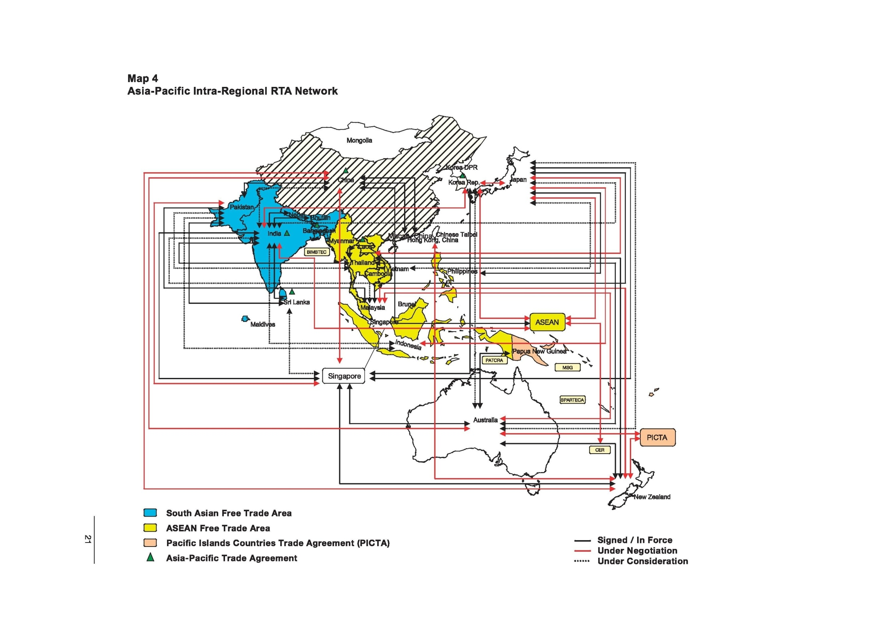

Slide 25
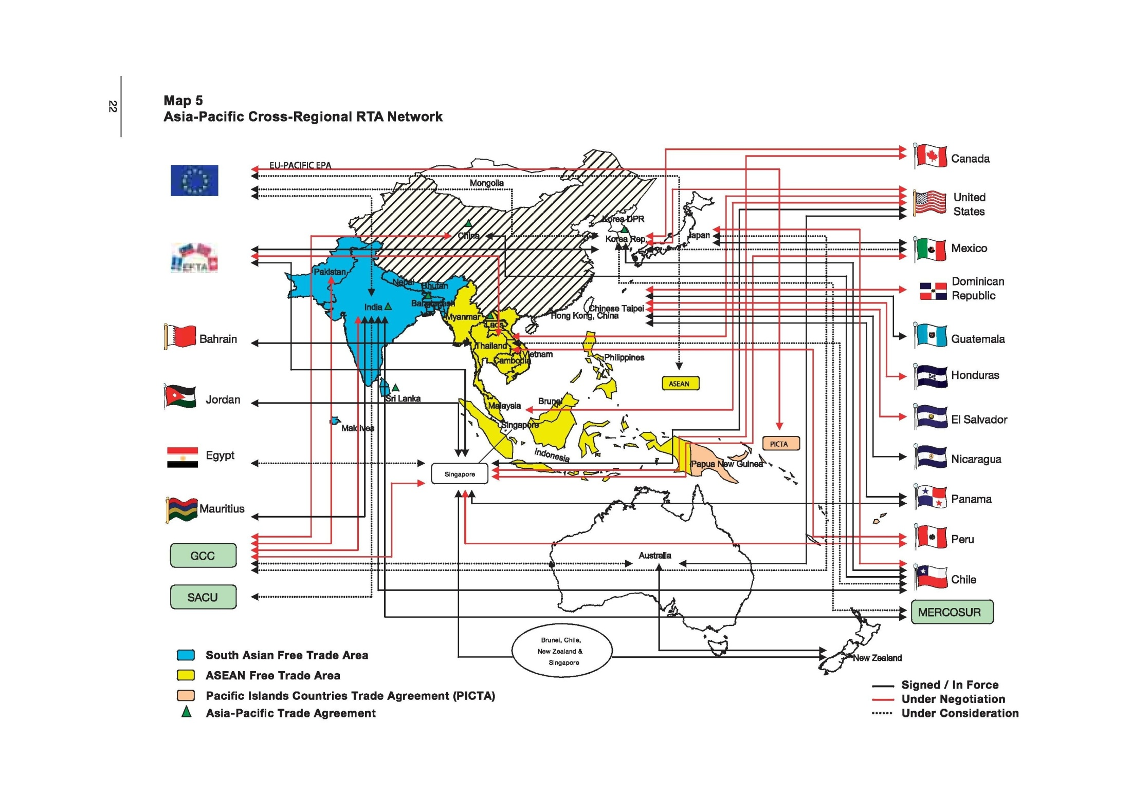

Slide 26
Thank You for Today!
Thank you for being a part of today's lecture on regionalism and globalization.
I hope you found the content informative and thought-provoking.
See You Next Week!
I look forward to continuing our exploration of these important topics in our next session.
If you have any questions or need further clarification, please don't hesitate to reach out.
Have a Great Week!
In the meantime, have a wonderful week, and we'll see you next time!

